Slide 1
Lab. 01
Logic Design Lab.
Spring 2014
Prof. Naehyuck Chang
(naehyuck@snu.ac.kr)
TA. Taeyoung Kim
(tykim@iris.snu.ac.kr)
TA. Duseok Kang
(kangds0829@iris.snu.ac.kr)
RUBIS

Slide 2
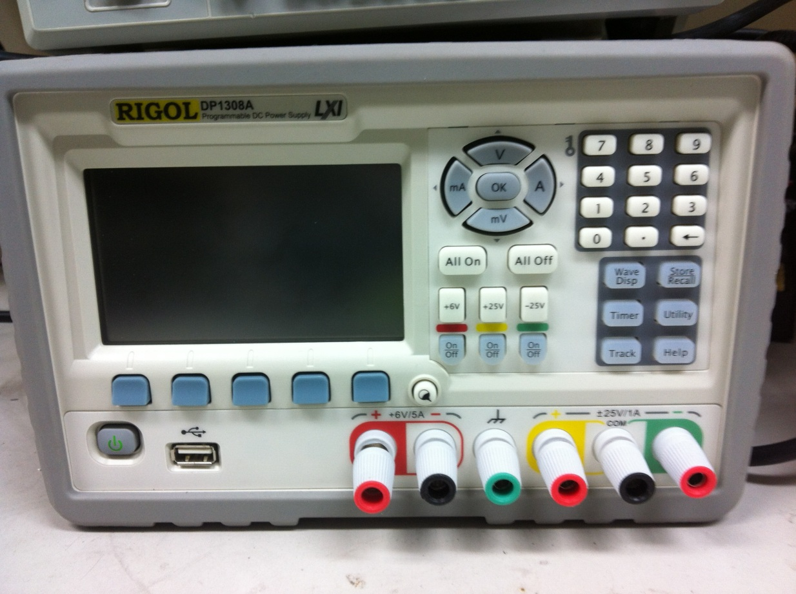
Introduction to instruments
DC Power Supply
A reference to a source of electrical power.
RUBIS

Slide 3
Introduction to instruments
Multimeter
An electronic measuring instrument that combines several measurement functions in one unit.
RUBIS

Slide 4
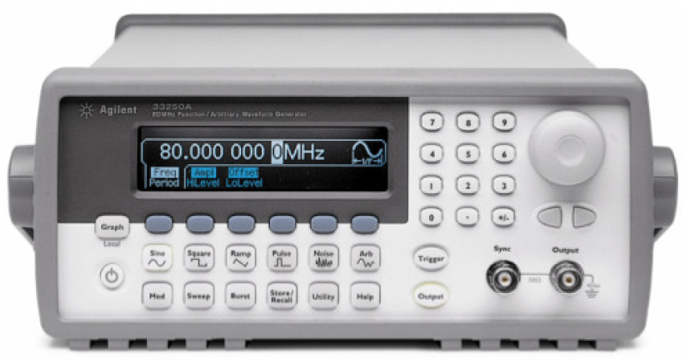
Introduction to instruments
Function Generator
A piece of electronic test equipment or software used to generate electrical waveforms.
RUBIS

Slide 5
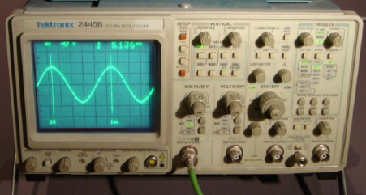
Introduction to instruments
Oscilloscope
A type of electronic test instrument that allows signal voltages to be viewed, usually as a two-dimensional graph of one or more electrical potential differences (vertical axis) plotted as a function of time or of some other voltage (horizontal axis).
See http://www.doctronics.co.uk/scope.htm for detail usages.
RUBIS

